Slide 1

Open-source in Finance

Slide 2



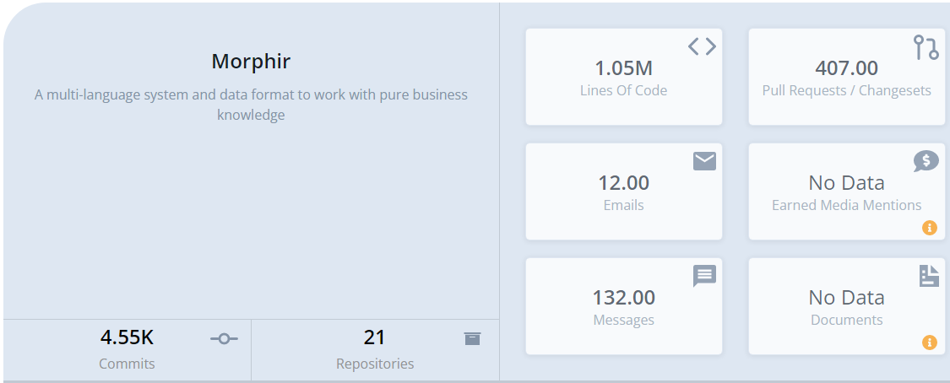
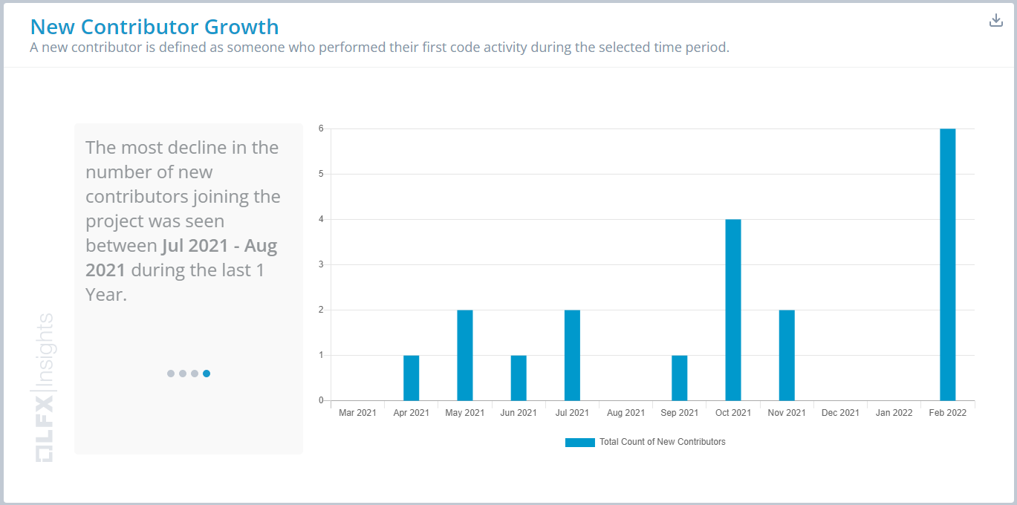


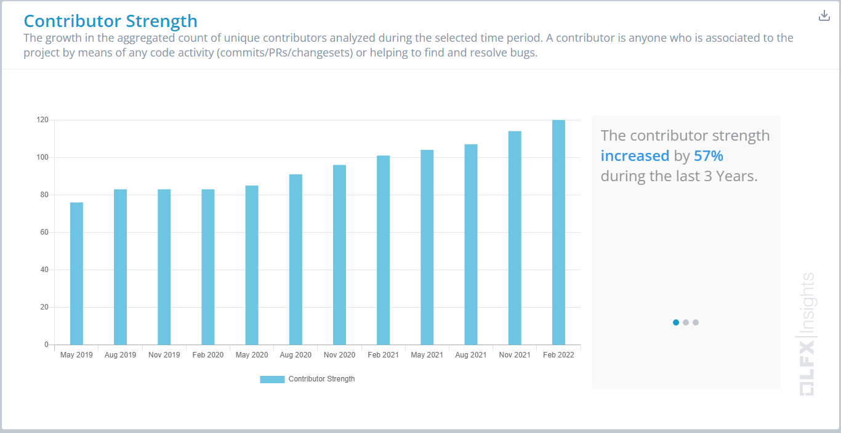
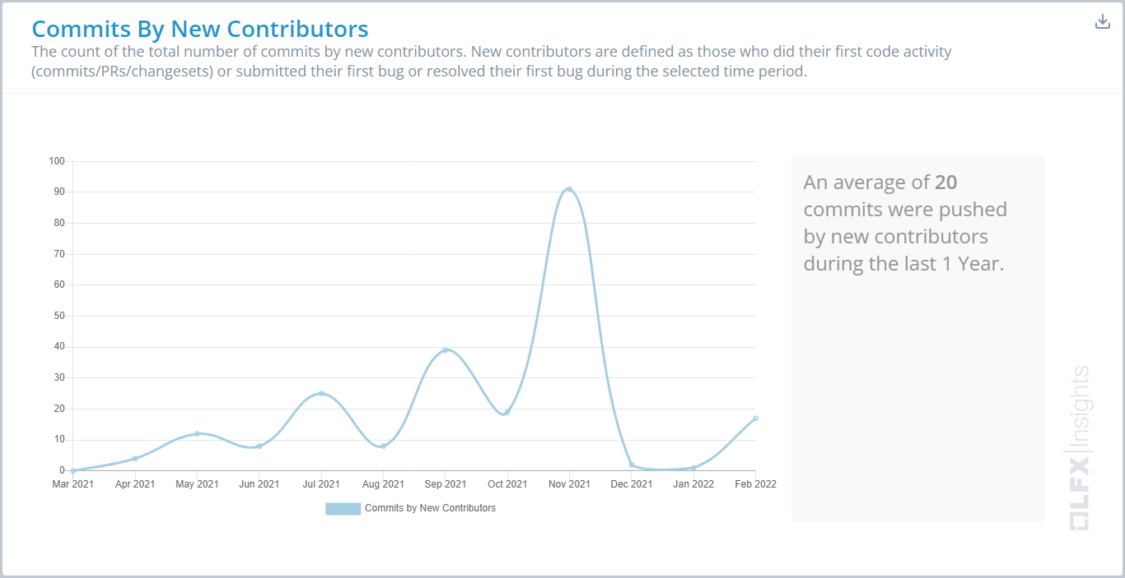
Project
Stephen Goldbaum
Morgan Stanley Executive Director

Slide 3
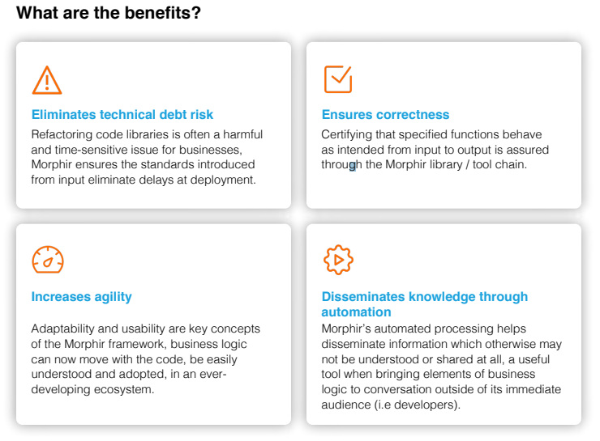
Motivation & Benefits
Universal Industry Challenges
Industry Transformation
More automation
Faster change
Be Better
Less risk
Increased efficiency
Increased transparency
Open Source
Giving back
Diverse talents and ideas
Good business sense

Slide 4
The Morphir Experience
From
Write spec
Interpret spec
Design
Code
Document
Integrate (data dictionary, etc.)
Test
Deploy
Realize interpreted something wrong
To
Collaborate on spec
Test
Deploy

Slide 5
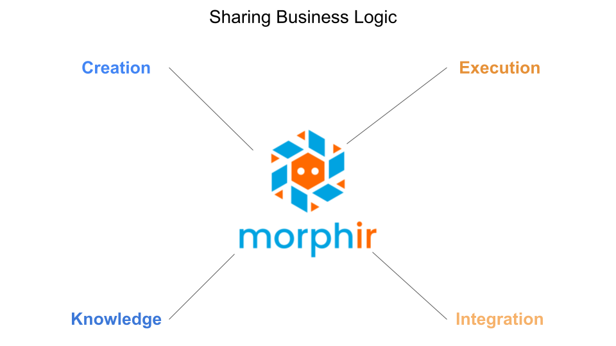

Slide 6
Creation
Demo of… (redo the sailboats to loans)
Also add a flow and architecture slide
Native
Elm
DSL
Open Source
Bosque
Legend
Scala
…

Slide 7
Correctness
Demo of…
Native
Insight
Test
Open-source
Bosque
Research

Slide 8
Knowledge
Demo of…
Native
Pure business logic
Insight
Audit
Graph
Open-source
Data Dictionary / Ontology
More graphs
Metadata management

Slide 9
Integration
Demo of…
We put a lot of knowledge into code, we should get a lot out of it, too.
Native
Data Catalog
Lineage
Open-source
Legend
Vendor and open-source tools

Slide 10
Execution
Demo of…
Native
Scala
JavaScript
Interpreted
Open-source
Dapr
Spring
TypeScript
Spark (Mention Antione, Delta Lakes, etc.)

Slide 11
Summary
Why
What it’s for
Successful outcomes
Augment experience and knowledge with open-source tools
OSS is important because…
Roadmap
Get involved

Slide 12
